Slide 1

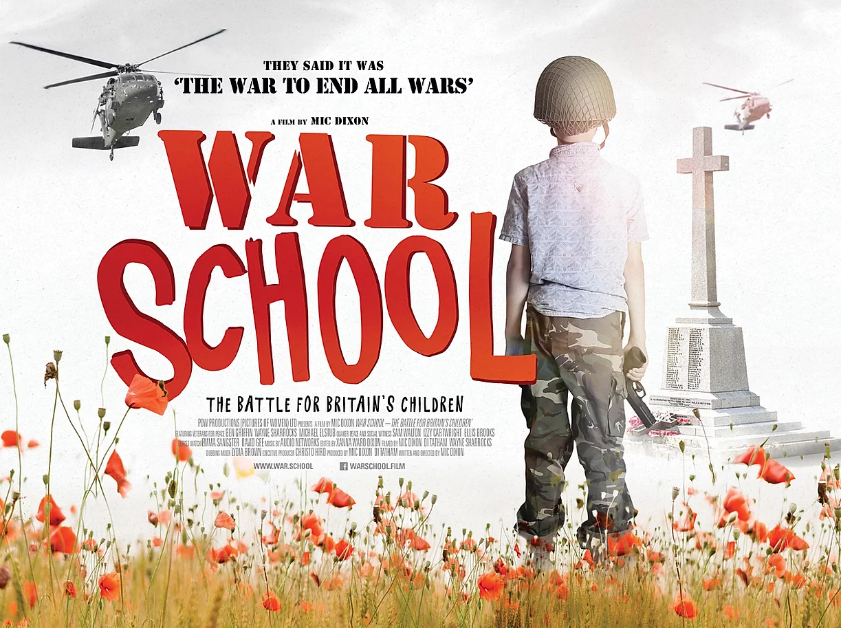
War School
These learning materials are inspired by the film War School: the battle for Britain’s children
The film raises important questions relevant to citizenship, wellbeing and moral development
The multimedia resources and activities have been designed to explore these questions from a critical thinking perspective
More at war.school
Notes:
The British Army recruits at 16. In fact, children can sign-up while they’re 15. This is unusual. Most wealthy nations wait until the age of 18. At the same time, a lot of activities, media and advertising are directly link to the armed forces, or bring a military character to young people’s lives. Some of that is the result of Britain’s cultural history; some of it is part of a deliberate Youth Engagement Strategy by the Ministry of Defence.
In that light, we think young people deserve more facts and context so they can answer questions like:
What are the risks of joining the armed forces?
What are my rights?
What do veterans say?
How does war already affect our lives?
What sort of relationship do we want with war?
These are questions all of us should reflect on, but particularly for young people being presented with the idea of supporting or participating in war it’s important that they receive balanced information in order to think critically and make informed choices.

Slide 2
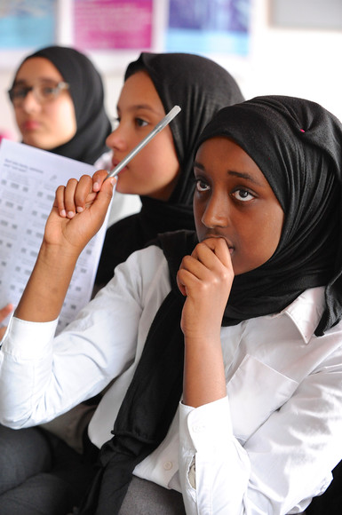
Important: Before you continue….
Exploring this topic is important, but it is also potentially distressing. Some learners have experience of war and violence. Some may have lost a friend or family member in the in the armed forces. Ensure you have a good understanding of your group and how they might feel.
We recommend Teaching Controversial issues from Oxfam to prepare.
Notes:
Find out more at https://www.oxfam.org.uk/education/resources/teaching-controversial-issues

Slide 3
Aim: | Explore how the armed forces and military issues affect peoples live in Britain | Age 15+
Learning Activities (See slide notes for details) | Minutes
Learning questions
Learners will have “silent conversations” responding to quotes from and about soldiers. Go to Silent conversations | 30
Quiz to explore what young people know about the British Army, the law and war. Go to Quiz | 20
Recruitment and training
Analyse recruiting adverts try to persuade people to join the army. Go to recruitment advertising What happens in army training? Go to training review | 30
Risk Assessment: Learners will use evidence and stories to critically assess the risks of joining the British Army? Go to risk assessment | 40
War and society
Define “militarism” and “militarisation”. Go to definitions Evaluate how militarised the UK is compared to other states in the movement based militarism spectrum | 20
Explore how war and the military is visible in our everyday lives, and what this means. Go to war and the military in our everyday life | 20
Reflection
Remembrance: using clips of veterans, reflect on who, what and why we remember past wars. Got to Remembrance reflection | 20
Video clips (5)
Printable Resources to download
www.quaker.org.uk/teaching
Notes:
These lesson activities provide a menu for learning. Choose the ones that make most sense for your context.

Slide 4
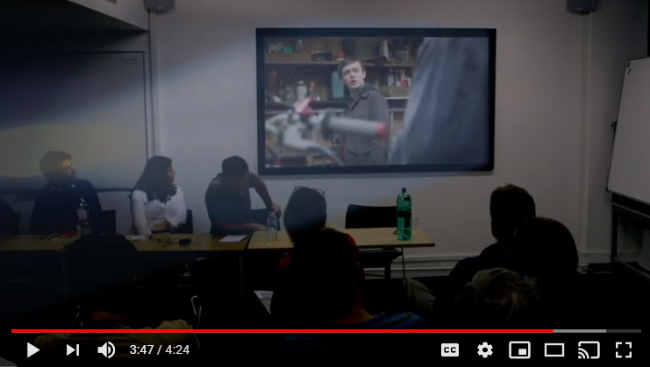
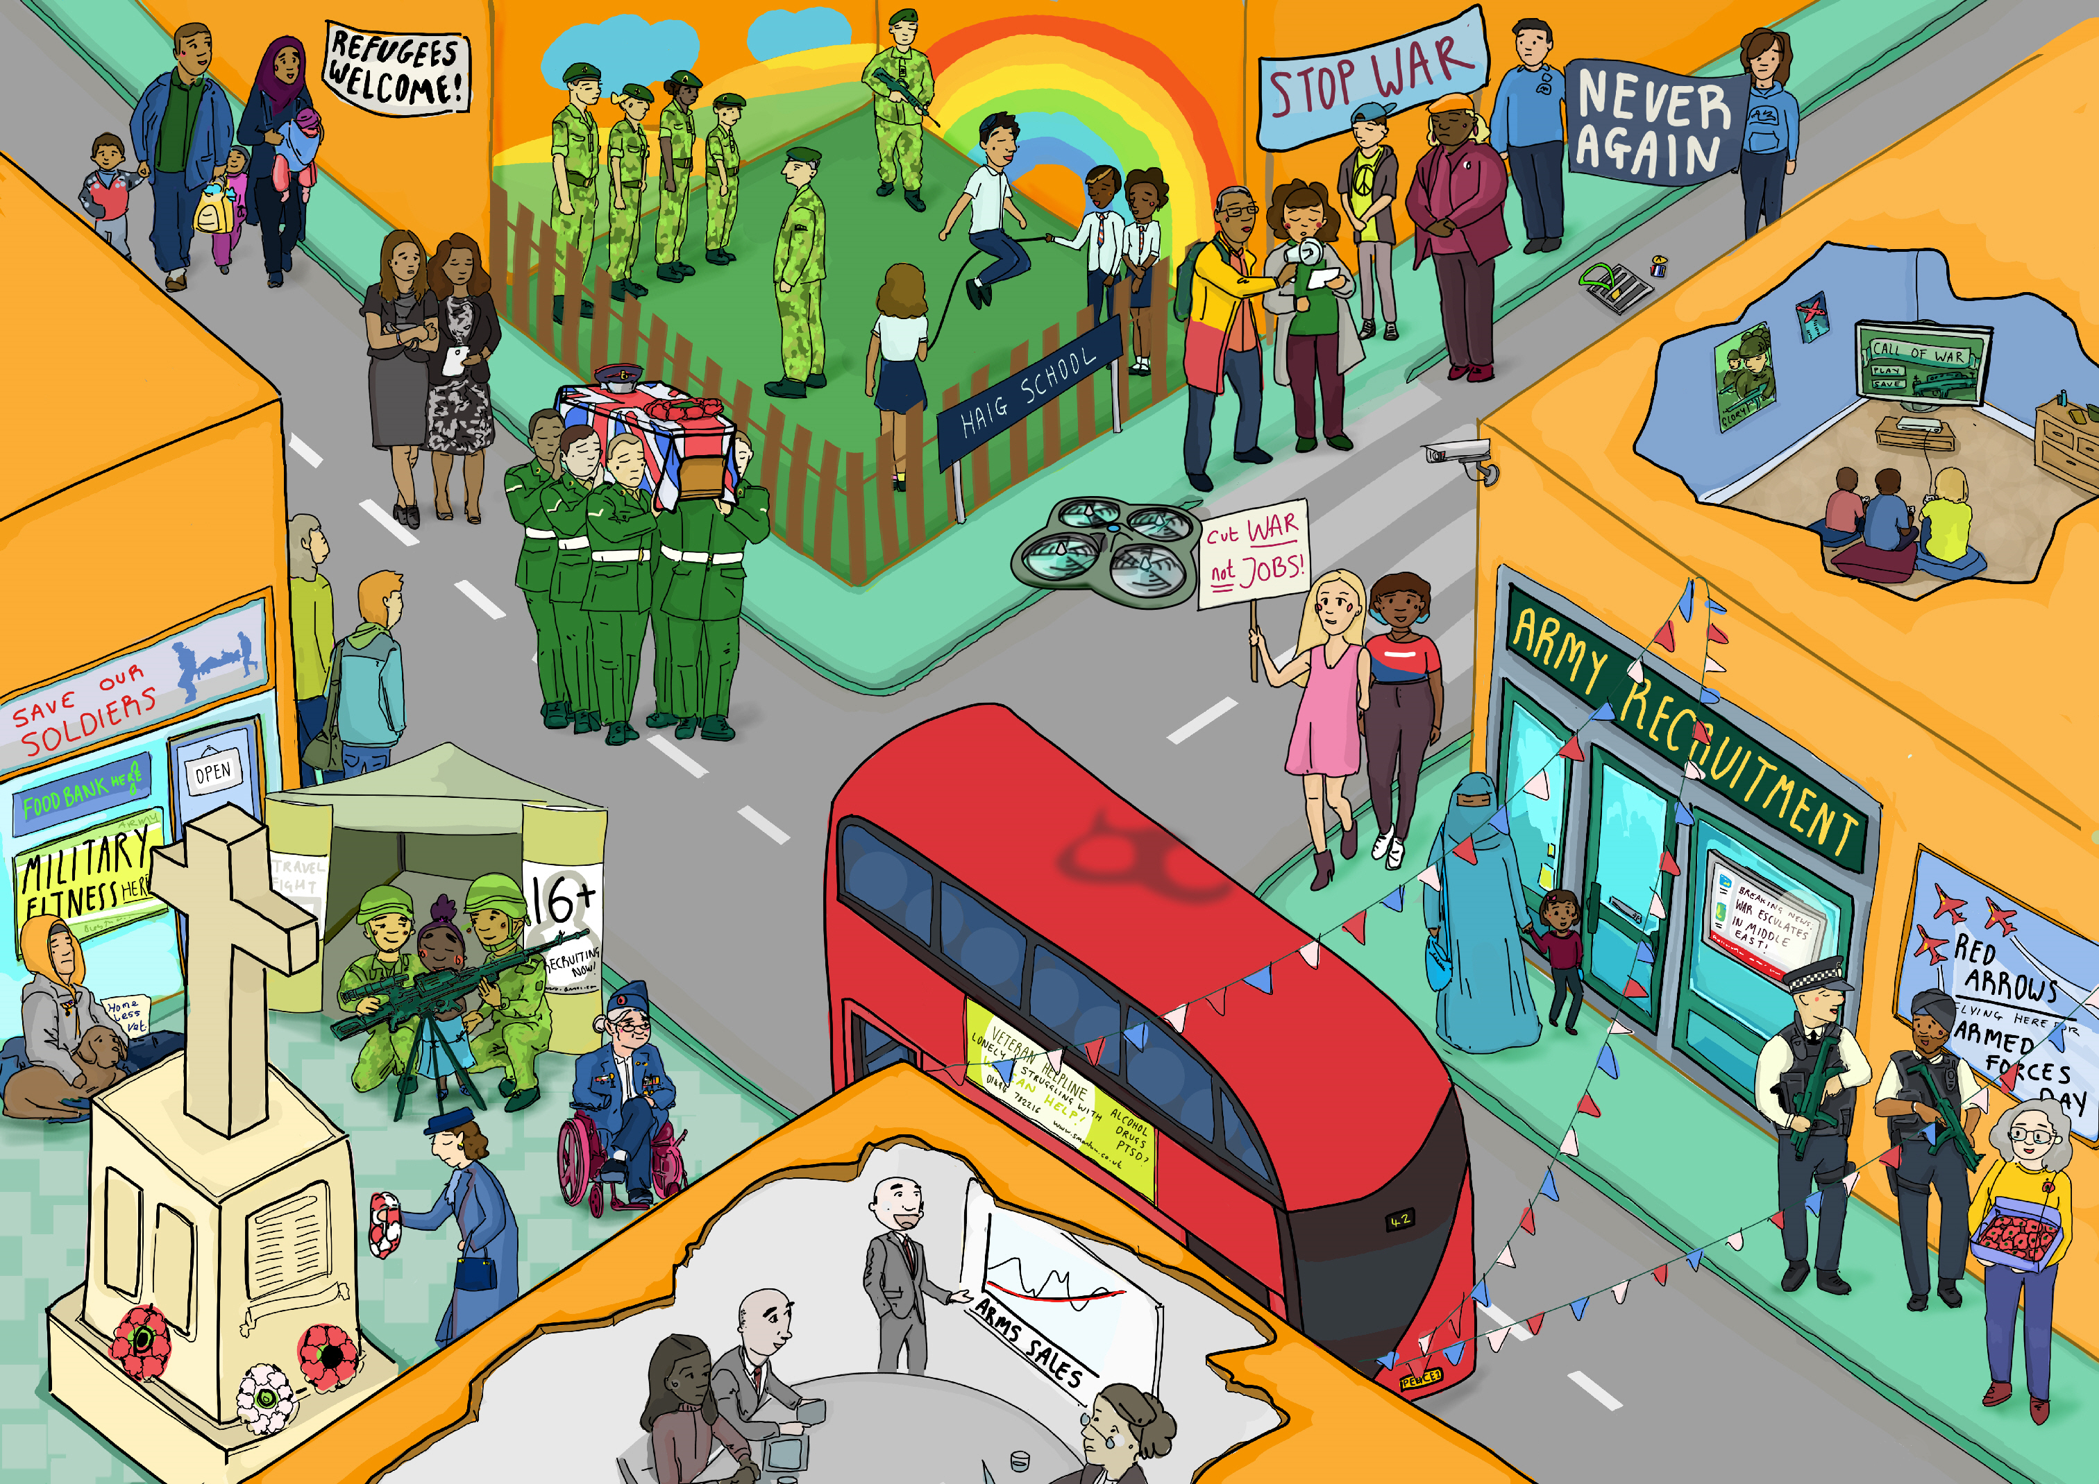
Printable Resources
The learning activities on the following slides signpost when you need one of these resources.
Printable Quiz and answers (A4)
War School Comic
Printable poster (A3)
Poster notes (A4)
Video clips
Printable Afghanistan deaths from BBC(A4)
Silent Conversation texts
Militarisation spectrum country cards
Risk Assessment handout
Slides outline
Notes:
These resources can be downloaded and printed as needed.

Slide 5
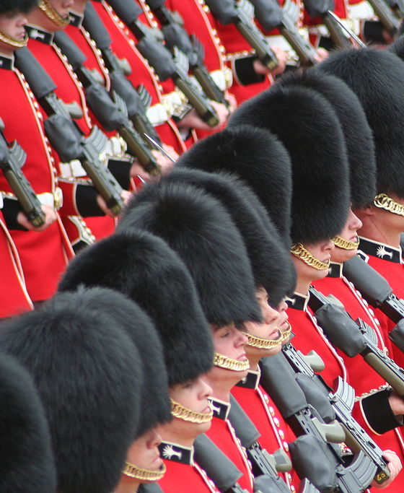
How do war and the military affect us in Britain?
Notes:
Introduction
Introduce this question to learners and explain this is what you are going to explore.
Use initial discussion to gauge what they already know as well as find out what they are curious about.
Learners can return to this question at the end of their activities.

Slide 6
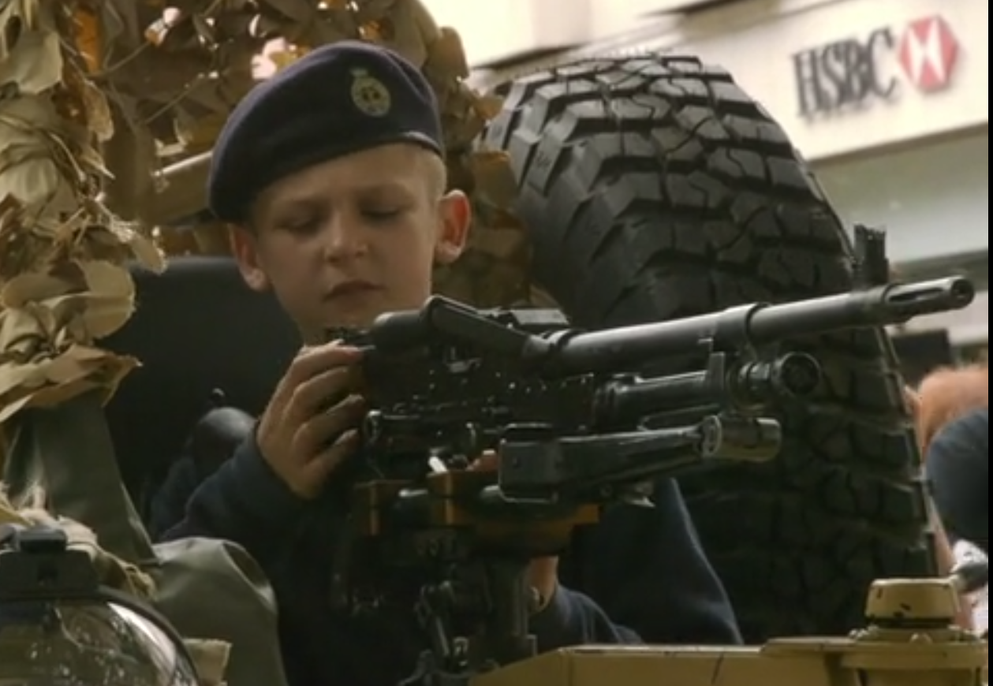
Why do you think the director called the film “War School”
Click to show poster and still…
Notes:
Explain that you will use a variety of clips to explore the question, “How do war and the military
affect us in Britain?”Some of the clips are drawn from “War School”.
Discuss with learners what the film might be saying about Britain with the title, “War School”
The subtitle is “The Battle for Britain’s Children”, which may provoke more ideas and discussion.

Slide 7
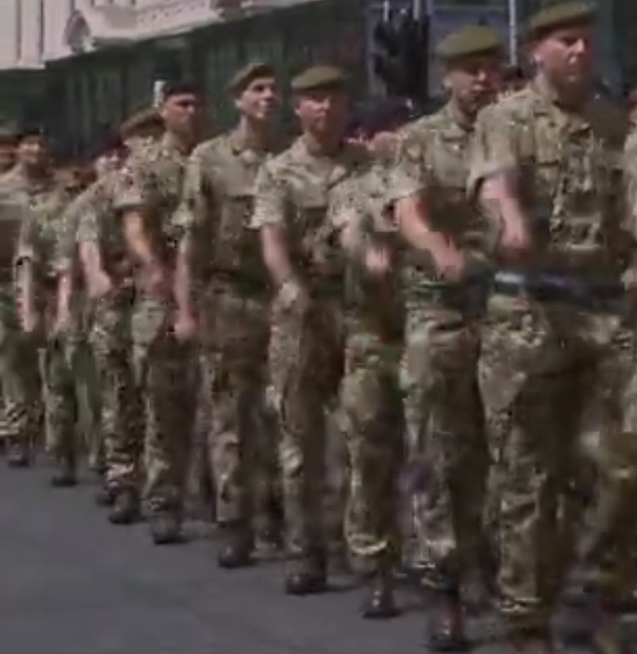
The military should have a bigger role in our lives.
AGREE
DISAGREE
Notes:
Opinion spectrum
Use this activity to help learners think and talk about big questions about war and the military. Student can move to the side of the room based on how they feel about the statement. You may want to repeat this activity during and at the end of the project.
AGREE ← → DISAGREE
The military should have a bigger role in our lives in Britain.

Slide 8
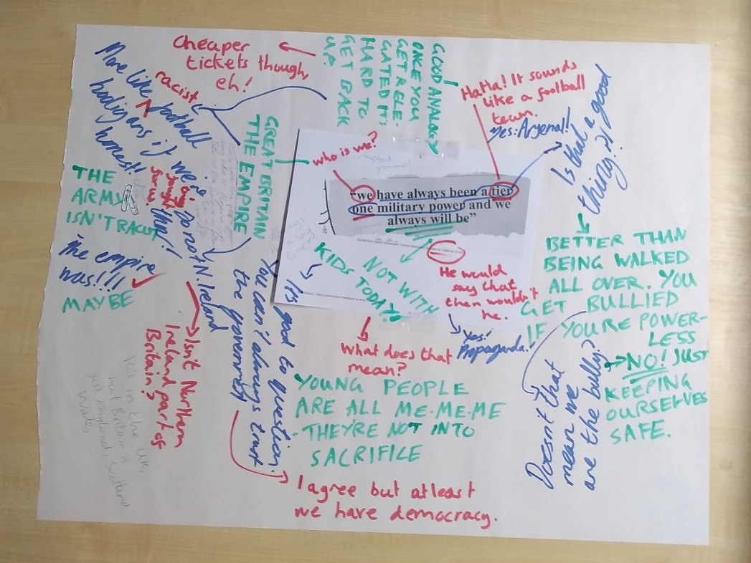
Silent conversations
Without speaking, add questions, comments and responses to your text.
Move around the room to join other silent conversations (keep your pen).
Download texts in Resources
Notes:
Silent conversations
This uses writing and silence as tools to help students explore a topic in depth. The idea is everyone has the chance to get their thoughts down.
The stimulus for the conversation are the printed texts provided in resources. Attach these into the middle of a much larger piece of paper.
Texts: the conversation starters
Quotes from Tommy Atkins, a poem about British soldiers by Rudyard Kipling
“War is organized murder”, a quote from Harry Patch, the last British WWI soldier to die. These words became a slogan for Veterans for Peace UK.
A quote from Colonel Allfrey about British Army recruitment
A quote from Bob Ainsworth, then British Minister for the Armed Forces, alongside an image about casualties in Iraq.
A quote from Gavin Williamson, then Secretary of State for Defence, about Britain’s role in the world
Quotes from veterans about their experiences in war
Lyrics from the Gold Fields of France (No Man’s Land), also known as Young Willy McBride.
Silent Conversation - instructions
Go over all of the instructions at the beginning to check understanding. Inform the class that this activity will be completed in silence. All communication is done in writing. Leaners will have time to speak in pairs and in the large groups later.
Each group receives a text on large paper and each learner needs a marker or pen. Some teachers have each student use a different colour to make it easier to see the back-and-forth flow of a conversation. The groups read the text (or look at the image) in silence. After students have read, they are to comment on the text and ask questions of each other using the big sheet. It’s fine to write simultaneously. The written conversation must start on the topic of the text but can stray wherever the students take it. If someone in the group writes a question, another member of the group should address the question by writing on the Big Paper. Students can draw lines connecting a comment to a particular question.
After a certain amount of time, students can rotate to look at other texts and add to those conversations. Allow this to pan out as much as feels right.
Finally, learners can talk in pairs and groups about thwat they wrote, and this can lead to whole group discussion.

Slide 9
True or False
?
Take the quiz online
http://bit.ly/war-school-quiz
Download printable quiz in Resources
What do you know about the UK military?
Notes:
True or False Quiz
This true or false quiz is designed to help learners understand the facts about the British military, and challenge common misconceptions.
You can go through the quiz online or download a printable version of the quiz from Resources.
We recommend this both to provoke citizenship-themed discussions, and to help people considering joining the British Army.
We also recommend the website Beforeyousignup.info

Slide 10
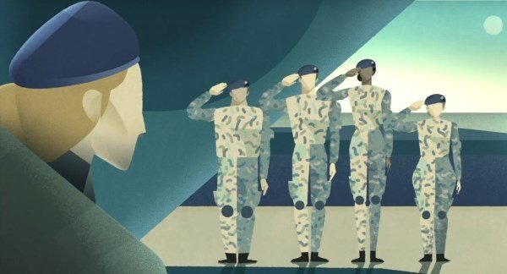
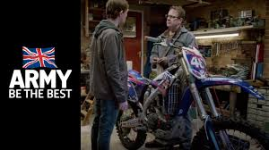
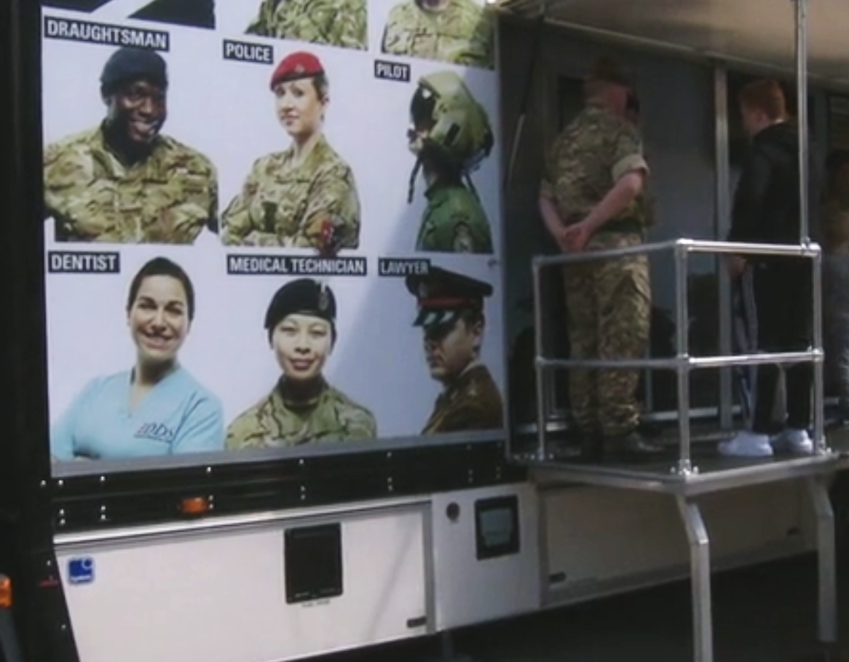
Recruitment advertising
How does the advertisements use:
Imagery
Music and sound
Language- the words used
Identity – who is speaking?
Emotion – what do you feel and why?
Who is the advert aimed at?
Do you think it is persuasive?
Watch “Will I be listened to?”
Watch “Become a better you”
Notes:
These are two recruiting adverts for the British Army. Allow students to analyse them.
Watch “Will I be listened to?” advert for the British Army? | https://news.sky.com/video/will-i-be-listened-to-in-the-army-11202093
“Become a better you” | https://www.youtube.com/watch?v=iGSAKuRAjWY
Ask students to take notes on these questions:
How does the advertisements use:
Imagery
Music and sound
Language- the words used
Identity – who is speaking?
Emotion – what do you feel and why?
Who is the advert aimed at?
Do you think it is persuasive?
“Will I be listened to?” – Learning points
- Size and power are very significant- the speaker goes from appearing small surrounded by giants to being the dominant figure at the top of the screen.
Music and sound: ominous music and murmuring male voices can be heard in the first part. New optimistic music comes in when she says she joined the army.
Words or phrases are used about being OUTSIDE the Army: E.g. dominated, normal, talked over, didn’t have a voice,
INSIDE the Army: E.g. go for it, different listened to, good at your job, lead, have your voice heard, where you belong. There is a binary opposition here.
Identity, a female soldier, an officer is speaking.

Slide 11
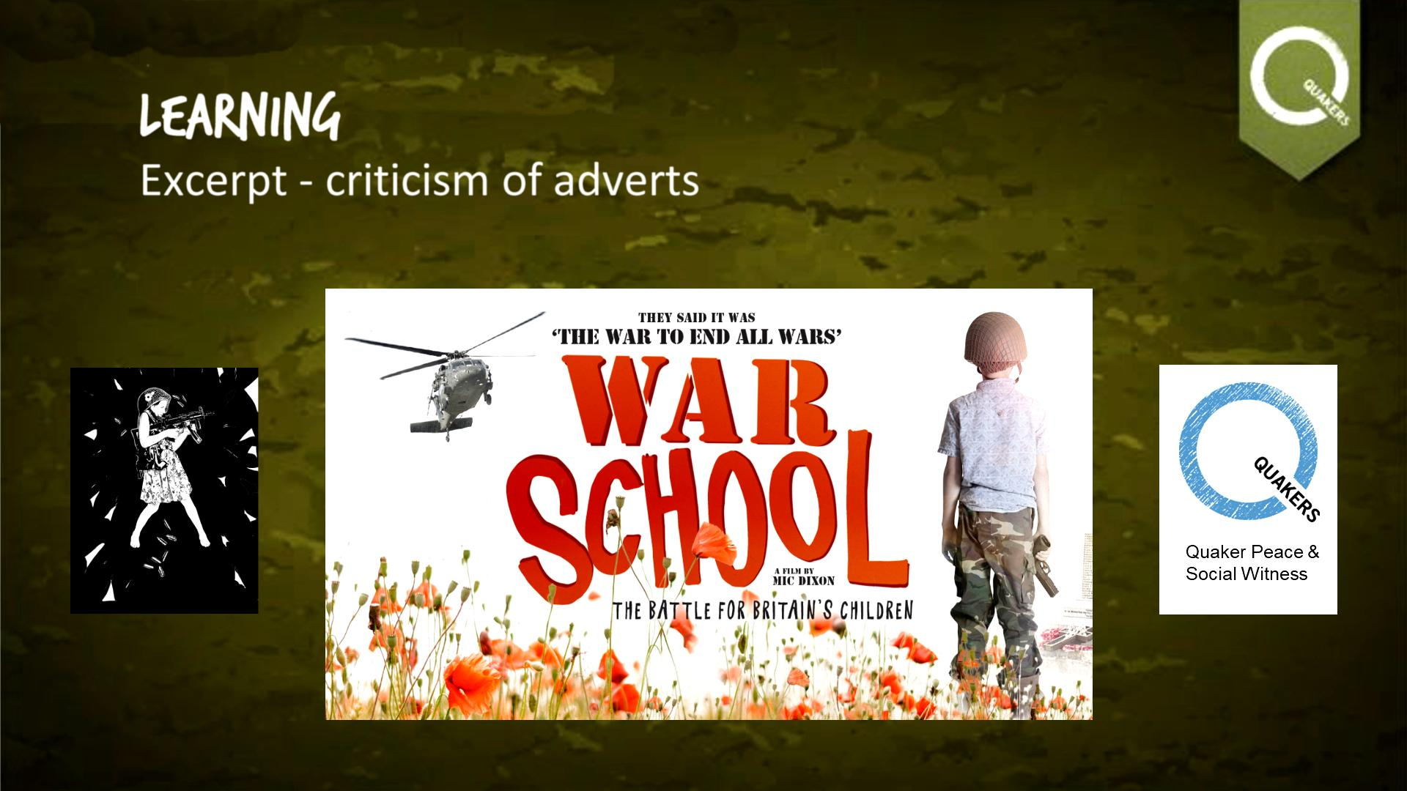
Recruitment
Watch criticism of British Army adverts
Notes:
These are critical responses to the adverts.
The previous activity was about how the adverts persuade an audience. To an extent, these critics are asking why the adverts are used.
Show the video and discuss with the students whether they agree with the criticism.

Slide 12
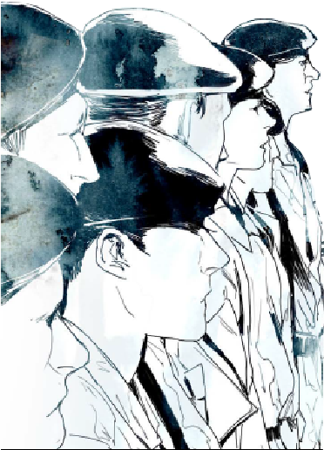

What happens in army training?
Watch Veterans Ben Griffin and Wayne Sharrocks describing their experience of Army training
Notes:
What happens in Army training?
‘Think-pair-share’ this question with learners
Show the clip from War School to see if it’s what they expected.
Discuss, were the descriptions of training surprising or what you’d expect? Why? Would you want to go through this?

Slide 13
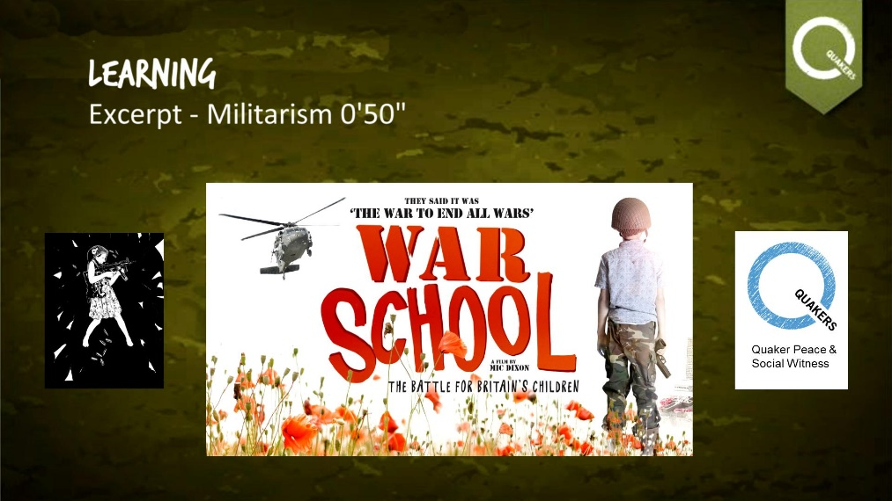
What is “militarism”
Watch militarism sequence used as background for War School credits
“The belief that a country should maintain a strong military capability and be prepared to use it aggressively to defend or promote national interests.”
Notes:
Militarism is an ideology. The dictionary describes it as “the belief that a country should maintain a strong military capability and be prepared to use it aggressively to defend or promote national interests.”
The video clip explores the imagery of a militarised society.

Slide 14
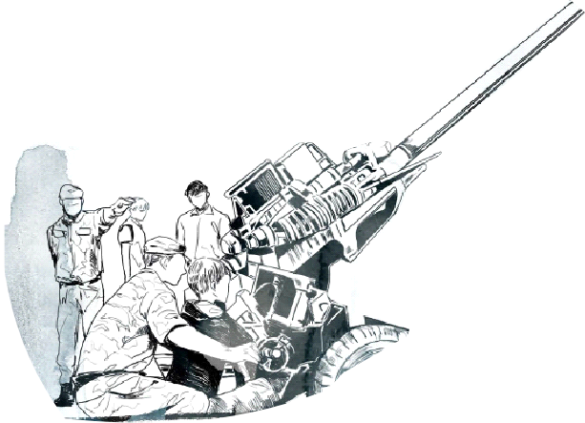
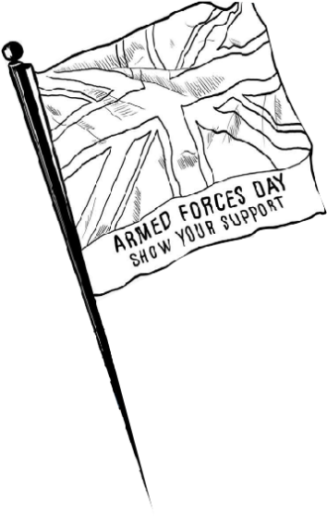
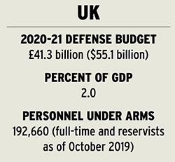

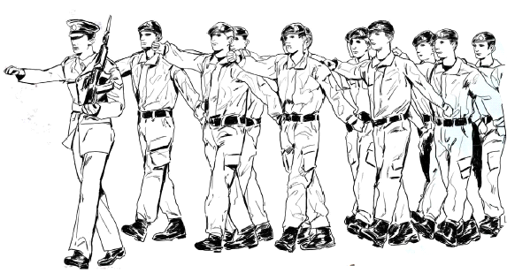
How militarised is your country?
How many heavy weapons
do you have?
How many people are
in your military?
How much do you
spend on the military?
Notes:
How militarised is your country?
Explain that societies and governments that believe in militarism might be more “militarised” if they put more money and resources into their military.
There is an “Global militarization index” updated every year. It is based on these three main factors:
Military spending compared with the GDP wealth of the country
Number of people in the armed forces compared with size of population
Number of heavy weapons
Pose the question: what rank of militarisation do you think the UK is based on these factors?
The answer is 68.
Go onto the next slide to compare with other countries.
https://www.bicc.de/uploads/tx_bicctools/BICC_GMI_2018_e.pdf

Slide 15
Militarisation spectrum
Least militarised
Most militarised
Download printable country cards in Resources
Notes:
Militarisation Spectrum
This activity is about exploring how militarised a country can be, and where the UK fits in.
Print the country cards two-sided.
• Begin by asking how militarised the UK is, but do not discuss this for long as the group are going to explore this.
• Give out country cards, one per person, but participants may initially only consider the first side (the name of the country).
• Ask participants to arrange themselves on a spectrum from most to least militaristic. Those without cards can still suggest positions. Most militarised < >Least militarised
• Now allow them to read the second side, which provides more detailed information about the country using possible indicators of militarisation.
• Participants can then re-arrange themselves in the light of this new info. There’s no ‘right’ answer.
• Review the spectrum so that the group finds out about other examples.
• In discussion you may draw out that countries are constantly changing, but that militarisation is a real phenomenon- the historical examples show the way the pendulum can swing in different directions over time
https://www.quaker.org.uk/documents/country-cards-for-militarisation-spectrum-dec2015

Slide 16
…
Download printable version in Resources
Clickable version online
Notes:
How is war visible in our everyday lives?
This image depicts different ways in which war and the armed forces affect life in Britain. You can use this to start many conversations as a class or in small groups.
The accompanying fact sheet can help provide more facts about the issues that arise.
Discuss with students: is militarism present? Where and how?
Find out more about the events shown poster with the interactive online version: http://www.quaker.org.uk/documents/everydaymilitarism-interactive-poster-opens-in-browser

Slide 17
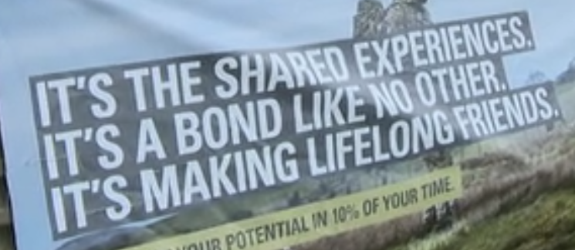
What are the risks of joining the army?
Notes:
What are the risks of joining the army?
Students will have the opportunity to do a thorough risk assessment of joining the British Army, but begin with a think pair share:
THINK: What do you think the risks of joining he British Army are?
PAIR: Make a list with your partner of all the risks you can think of.
SHARE: Join another pair and compare your lists: can you add anything?
The next slide explores the rate of death, followed by a risk assessment activity.

Slide 18
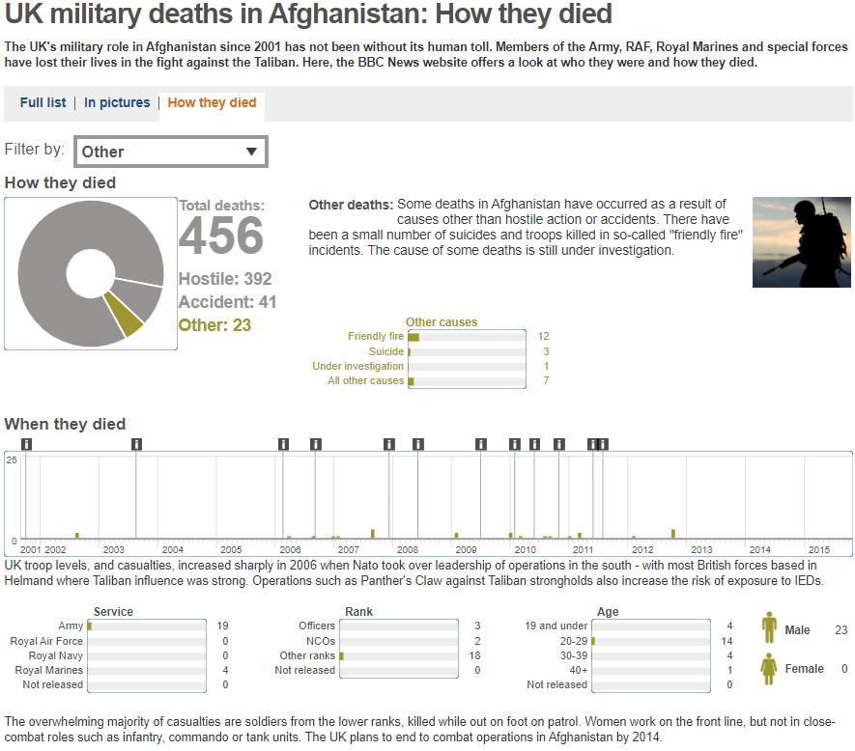
Killed in action…
Download fact sheet in Resources
Source: BBC
Notes:
This information is from the BBC website:
https://www.bbc.co.uk/news/uk-10634173
It informs the risk assessment activity

Slide 19
Risk Assessment
Risk | Notes | Severity level (1-10) | How likely (0.0 → 1.0) | Threat level (severity X likelihood)
EXAMPLE: Friendly fire deaths | When you are killed accidentally by your own side’s weapons. 4 UK soldiers were killed in 2012. | 10 | 0.0001 (one person in ten thousand) | 0.001
Physical injury
Mental health problems such as PTSD
Economic problems after you leave such as being jobless or homeless
Being bullied in the Army
Death
Seeing friends hurt
“Moral injury” | Put another way, guilt. This is the sense that you have done something against your own values that can never be undone. More
Click 1: view completed “example” row.
Click 2: see other suggested categories
Click 3: see a definition of moral injury.
Notes:
This threat assessment tool requires numeracy skills and judgement. It is similar to risk assessments conducted in the world of work.
Explain you need information to understand risk. For example, it would be really bad to be sat on by an elephant, but how likely is that? Famously more people are killed in vending machine accidents than by sharks.
Go through the headings:
“Risk” is the danger you are trying to assess. Notes is for information about it.
“Severity” basically means the “badness”- how bad would it be if this happened. This is measured out of 10.
“How likely” is a probability, so is expressed as a decimal figure between zero and one. “0” means that is absolutely impossible; “1” means that it is certain to happen. You may want to note that the likelihood increases the longer you are exposed to a risk- if you roll a di a 1,000 times, the probability of rolling a Five approaches “1”.
Finally, the “Threat level” is based on the calculation of severity multiplied by likelihood.
Note, this process is an estimate: is based on your best judgement- an “educated guess”.
Click to reveal the first row, “Example Friendly Fire” to show the process works. Explain that 4 British soldiers were killed by friendly fire in 2012 (see https://www.bbc.co.uk/news/uk-15188729), but there were about 40,000 British personnel deployed that year*, so the likelihood of being killed by friendly fire was only 0.0001. That is one in every 10,000 troops.
To complete the table, learners will need resources. Use the War School comic and the BBC fact sheet to help. *Number of troops deployed: https://assets.publishing.service.gov.uk/government/uploads/system/uploads/attachment_data/file/498068/PUBLIC_1439893241.pdf
Now give learners the chance to complete a risk assessment themselves. You may want to use the slide and videos on moral injury to explain this idea.

Slide 20
Risk Assessment - answers
Risk | Notes | Severity level (1-10) | How likely (0.0 → 1.0) | Threat level (severity X likelihood)
Physical injury | 7,300 were treated in field hospital for battlefield injuries, non-combat wounds or disease. 220,000 British personnel have served so far in the Iraq and Afghan campaigns. | 7 | 0.033 | 0.231
Mental health problems such as PTSD | Figures are disputed. Help for Heroes say 59,992 (27.2 per cent) | 8 | 0.272 | 2.176
Economic problems after leaving such as being jobless or homeless | 50,000 are coping with mental health conditions, 10,000 are in prison, on parole or on probation and 6,000 have no permanent address (2018). | 8 | 0.1 | 0.8
Being bullied in the Army | We don’t know exactly how common it is – the government is doing a review. Some recruits have killed themselves after bullying.
Death | 456+179 out of 220,000 soldiers in Iraq and Afghanistan died, but not all wars are the same and not all soldiers fight. | 10 | 0.0027 | 0.027
Seeing friends hurt | This is very hard to study – estimate.
“Moral injury” | Put another way, guilt. This is the sense that you have done something against your own values that can never be undone. More
Notes:
These are some answers to the risk assessment.
No risk can be fully understood, so you may want to discuss how much learners trust the numbers.
Some of the risks are hard to put numbers to, such as moral injury or seeing friends hurt.
Take some time to reflect on these risks.

Slide 21
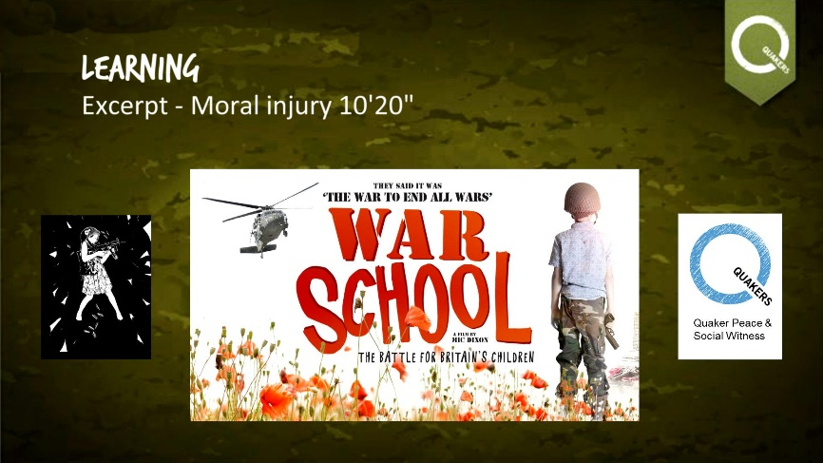
“Moral injury”
Watch Veterans sharing their wartime experiences
Notes:
This activity is to understand the challenging concept of “moral injury.”
Moral injury refers to an injury to an individual's moral conscience and values resulting from an act of perceived moral transgression, which produces profound emotional guilt and shame, and in some cases also a sense of betrayal, anger and profound "moral disorientation".
In simpler words, this is a sense of deep guilt or shame that it is hard for people to leave behind.
Refer to the War School comic section on screen. Explain that British soldiers have sometimes killed civilians, and some have been found to have tortured people. This can lead to moral injury. It might be that a person just witnesses these things.
Check with your group whether they are willing to listen to accounts by British veterans describing violence.
If so, play the clip, Moral Injury?
It informs the risk assessment activity

Slide 22
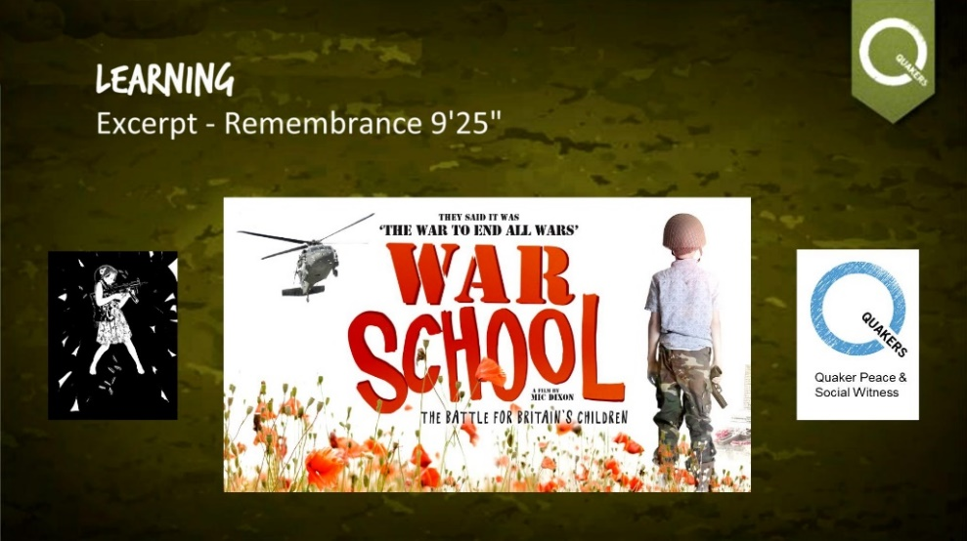
Remembrance
What should we remember?
Watch ‘Remembrance’ sequence from
War School
Notes:
Remembrance Reflection
This section is to reflect on war as a whole. It could be used at Remembrance or any time of year.
Remind students of the idea of Remembrance: on the anniversary of the end of World War I, people reflect on war.
Watch this short video clip of people discussing what Remembrance means to them: https://www.youtube.com/watch?v=pqjwScKT3Cc&t=3s
Ask learners to note down people affected by war, mentioned by veterans. Can they think of anyone else?
Spend time in Remembrance
Extension: “to end all Wars lesson” https://www.tes.com/teaching-resource/to-end-all-wars-remembrance-1918-2018-11877618

Slide 23
How do war and the military
affect us in Britain?
This is the question we started with.
Write a reflection on how you think war and the military affect our lives in Britain, and your feelings about that.
Notes:
Final reflection
This final activity could be discussion or a written task. Take this chance to digest what has been learnt and what it means for learners.

Slide 24

These learning materials were developed by Quakers in Britain as a companion to War School
Quaker Peace & Social Witness
Notes:
Find more at www.war.school

